Slide 2
add
00
00
40 frame
Q06
Q01
Q02
Q04
Q03
Q05
00
Training
00
Prediction
00
Strategy 00
Q01
Training
Q01, Q02, Q03, Q04, Q05…
Prediction
00
Strategy 00’
Strategy 01
Training
Q01/ Q02/Q03/Q04
Prediction
Q05
Training
Q01/ Q02/Q03/Q04 +add
Prediction
Q05
Strategy 02

Slide 3
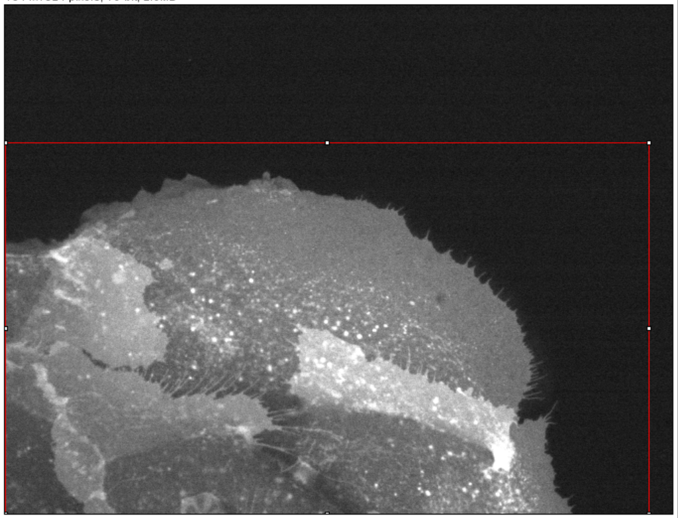
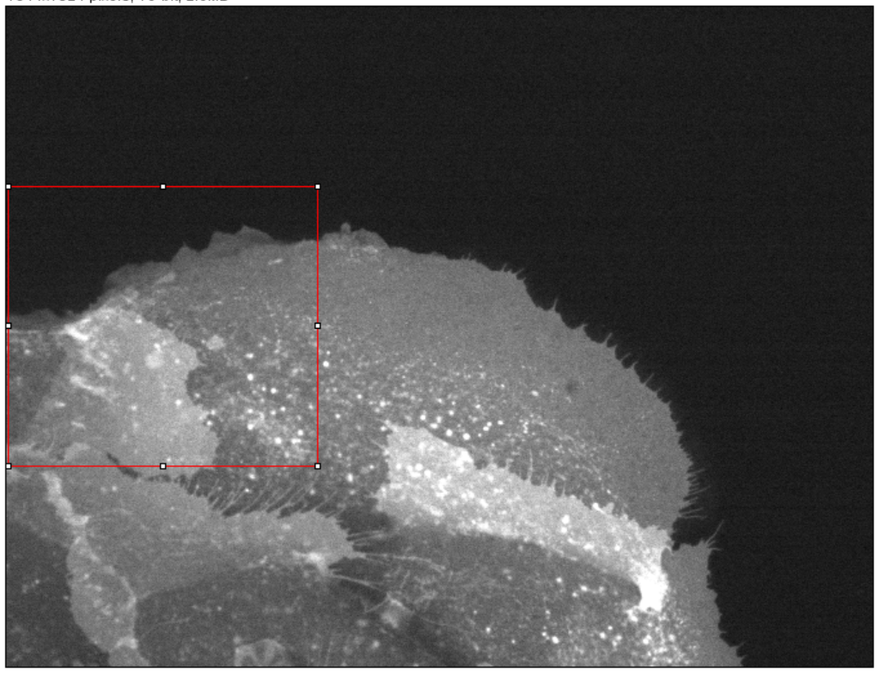
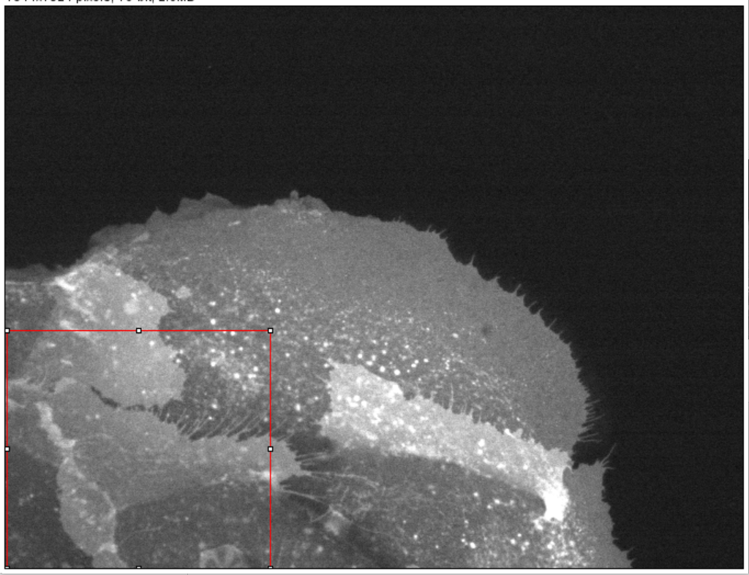
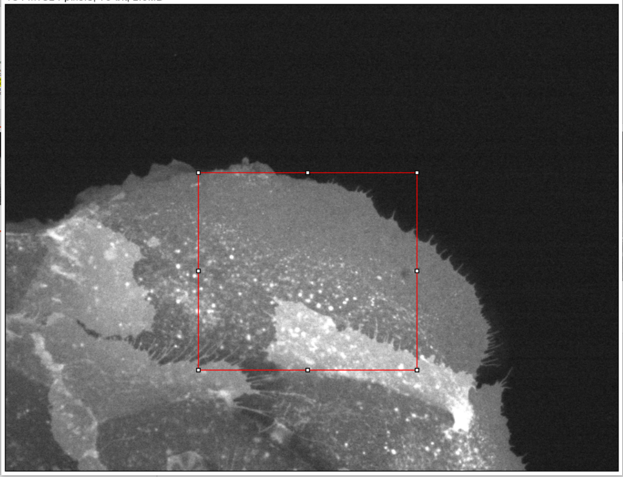
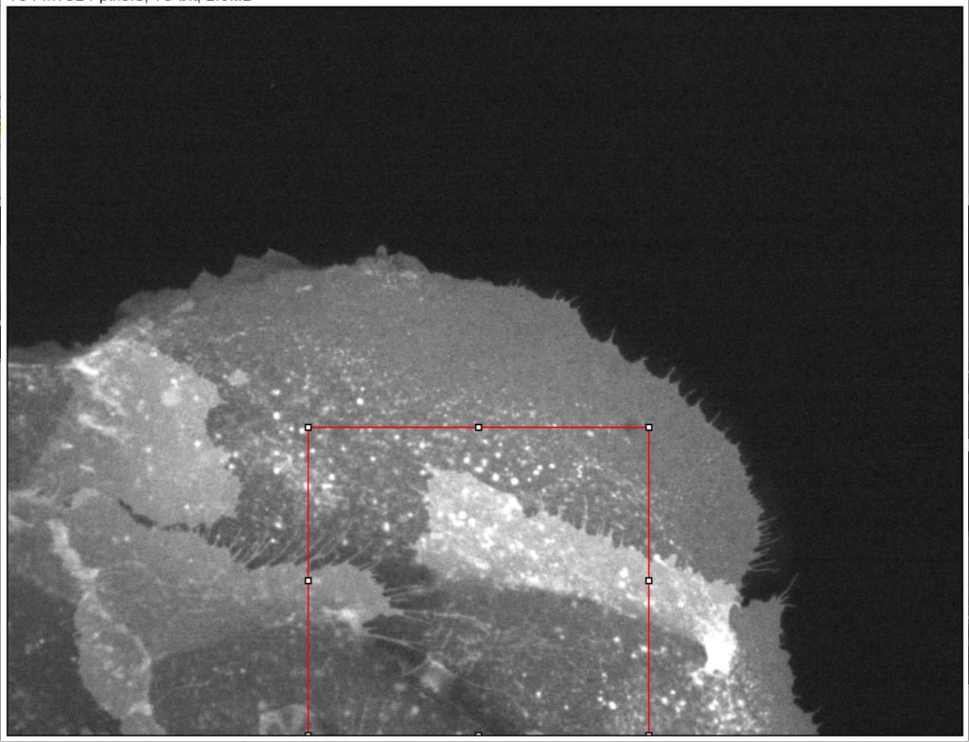
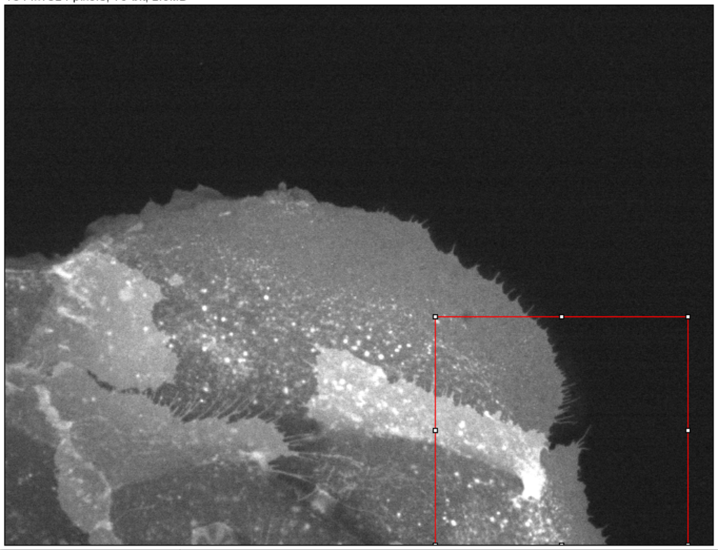
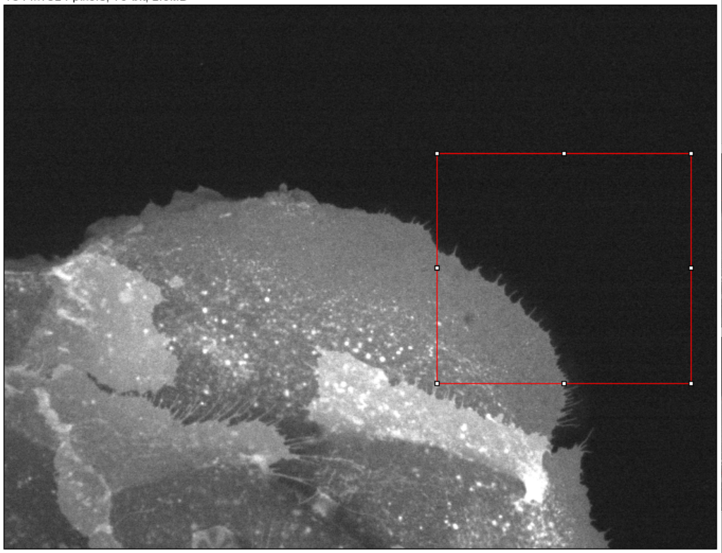
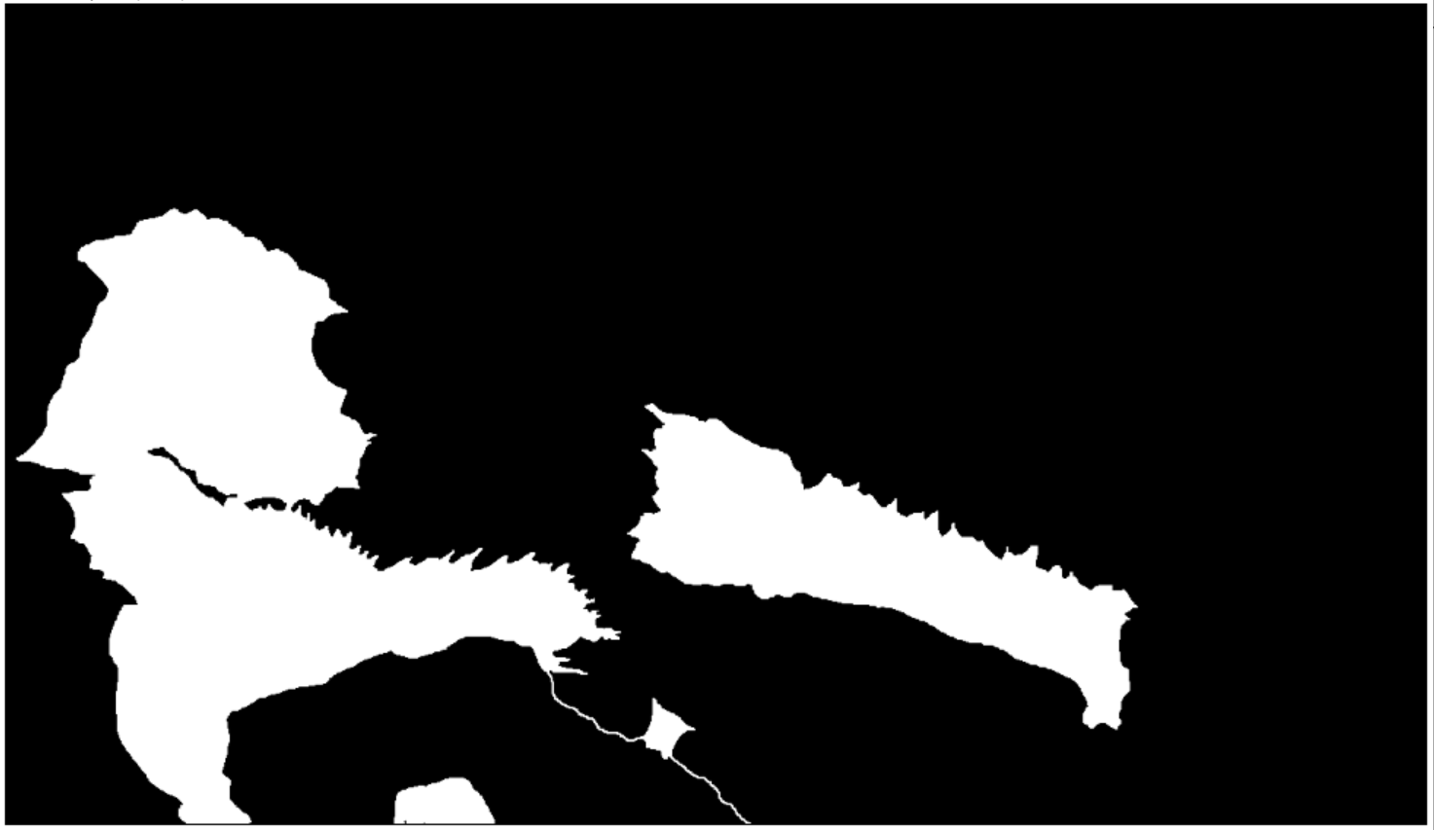
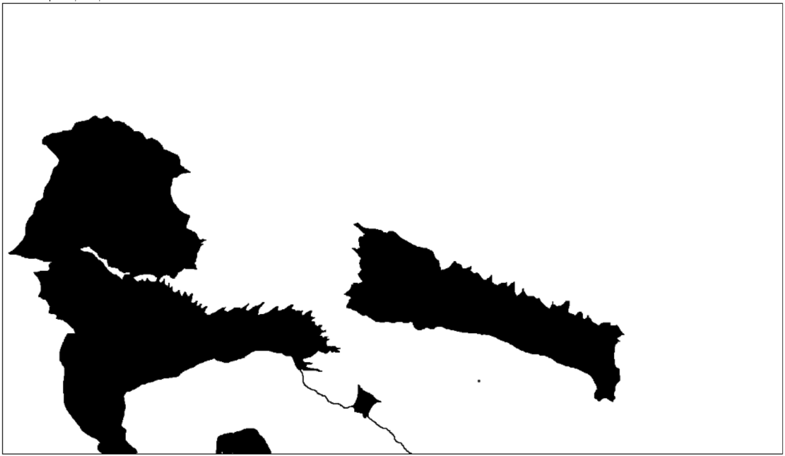
\\research.wpi.edu\HeeJune\Segmentation_Image\Cryptic Lamellipodia
\strategy_050520.pptx
00
ADD
A
C
F
B
D
E
mask
Mask_i
White = 255
Black = 0
Cryptic lamellipodia labelled
(Cryptic lamellipodia)^{C} labelled
 | Training | Prediction | Training mask |  | Training | Prediction | Training mask
Test 0 | "00" | "00" | mask | Test 0' | "00" | "00" | mask i
Test 1a | A,B,C,D | E | mask | Test 1b | A,B,C,D | E | mask_i
 | A,B,C,E | D |  |  | A,B,C,E | D
 | A,B,D,E | C |  |  | A,B,D,E | C
 | A,C,D,E | B |  |  | A,C,D,E | B
 | B,C,D,E | A |  |  | B,C,D,E | A
Test 2a | A,B,C,D | F | mask | Test 2b | A,B,C,D | F | mask_i
 | A,B,C,E | F |  |  | A,B,C,E | F
 | A,B,D,E | F |  |  | A,B,D,E | F
 | A,C,D,E | F |  |  | A,C,D,E | F
 | B,C,D,E | F |  |  | B,C,D,E | F

